Slide 1

Adaptive Email Client App
Team members :
V.CHANDRU(D733BD5CA22B9DAB2BE4F49C2539DEF0)
B.BALAJI( B4E3B06C6EAC8FE86014894E7BA58F92)
G.CHANDRU(C9D53490DD0BF4A806E4143CB4977827 )
C.PERIYASAMY(CE67A0882177F0993374F5748D3058F3)

Slide 2

Streamlining Email Management for the Modern Professional
1
Reduce Clutter
2
Boost Productivity
The Adaptive Email Client App helps you organize your inbox and manage your email effectively.
The app allows you to focus on important tasks, streamline your workflow and make the most of your time.
3
Save Time
Spend less time sorting through emails and more time on tasks that matter.

Slide 3
Intelligent Inbox Sorting and Prioritization
Smart Categorization
Priority Level
The app automatically sorts emails into categories based on sender, subject, and content.
Emails are prioritized based on their importance and urgency, ensuring you attend to critical messages first.

Slide 4
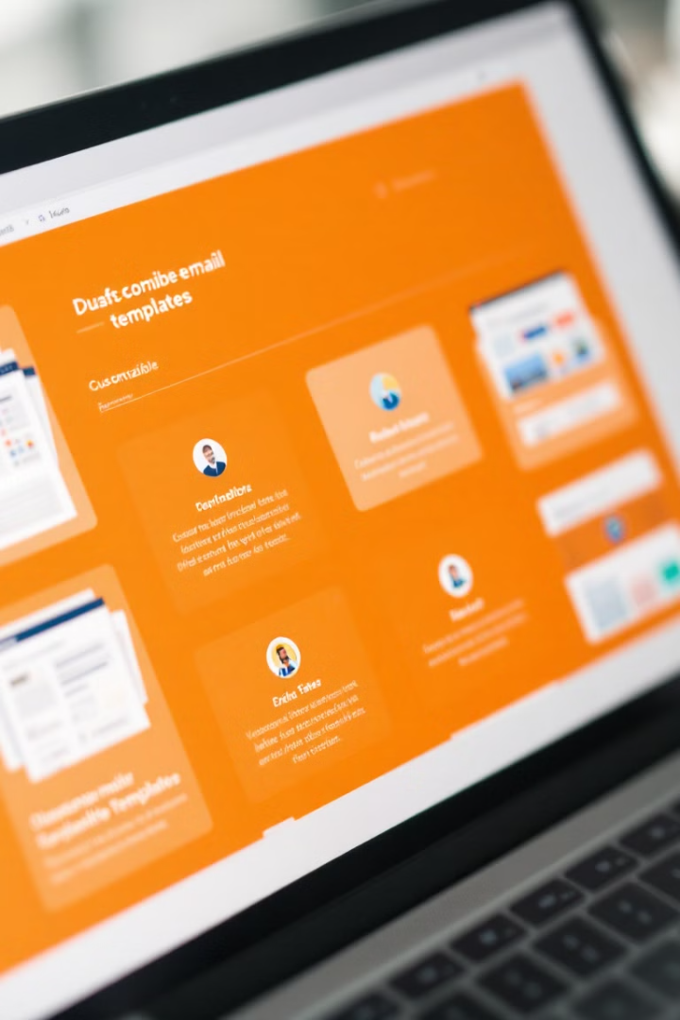
Customizable Email Templates for Efficiency
Pre-Built Templates
Personalize Templates
Save time and effort with pre-built templates for common email scenarios, such as confirmations, greetings, and reminders.
Customize templates with your own branding, text, and formatting to reflect your personal style and preferences.

Slide 5
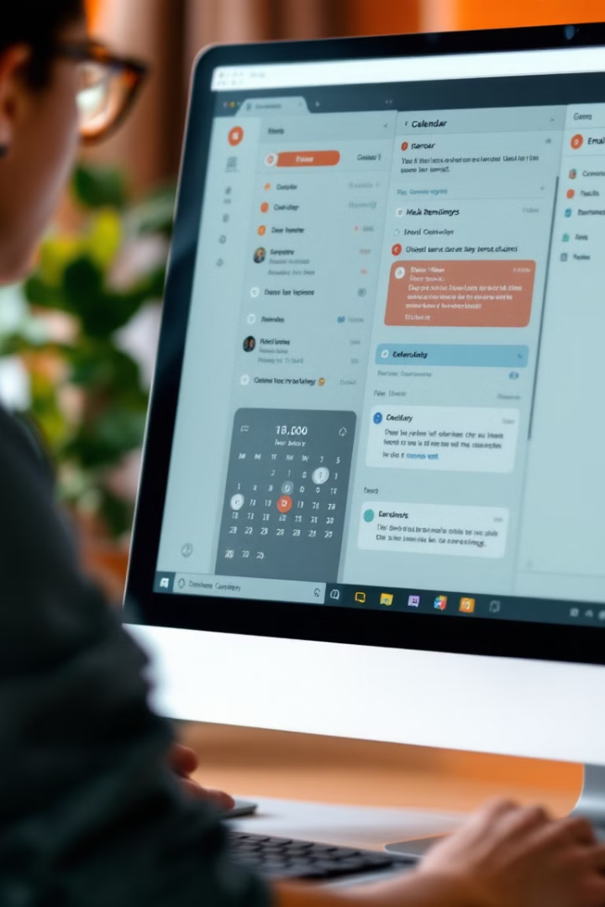



Seamless Integration with Calendars and Productivity Tools
Calendar Sync
Access your calendar directly within the app to schedule meetings and events.
Task Management
Create and manage tasks directly from emails, ensuring all your work is centralized and organized.
Productivity Tools
The app seamlessly integrates with popular productivity tools, such as task managers and note-taking apps.

Slide 6
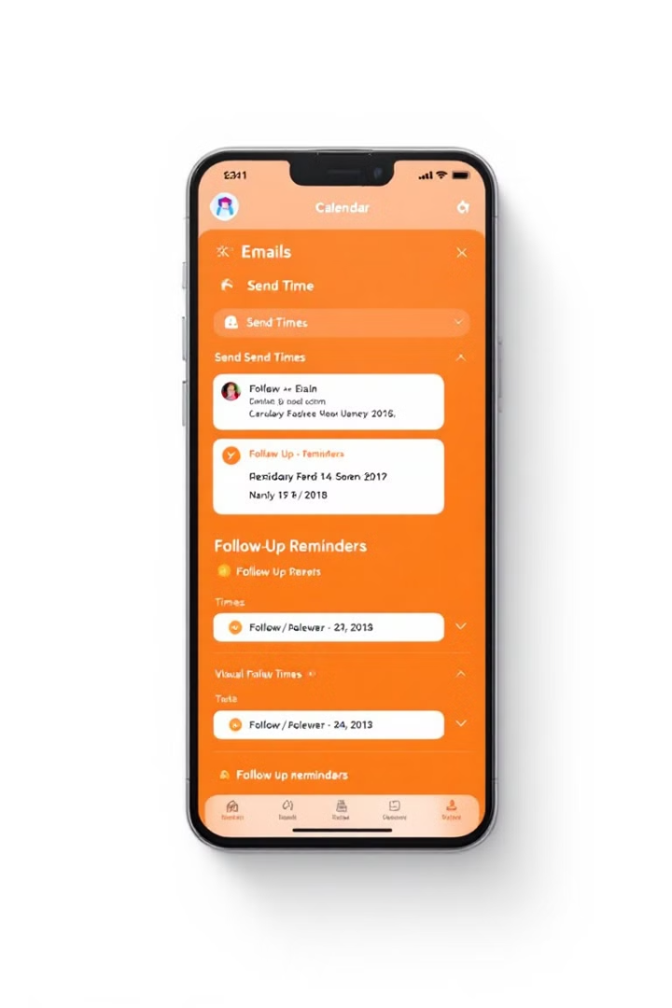
Automated Email Scheduling and Follow-ups
1
Scheduling
Schedule emails to be sent at a specific time or date, ensuring your messages are delivered when they are most likely to be seen.
2
Follow-up Reminders
Set reminders to follow up on unanswered emails, increasing the likelihood of receiving a response.
3
Automated Sequence
Create automated email sequences to nurture leads, provide updates, or follow up after a meeting.

Slide 7
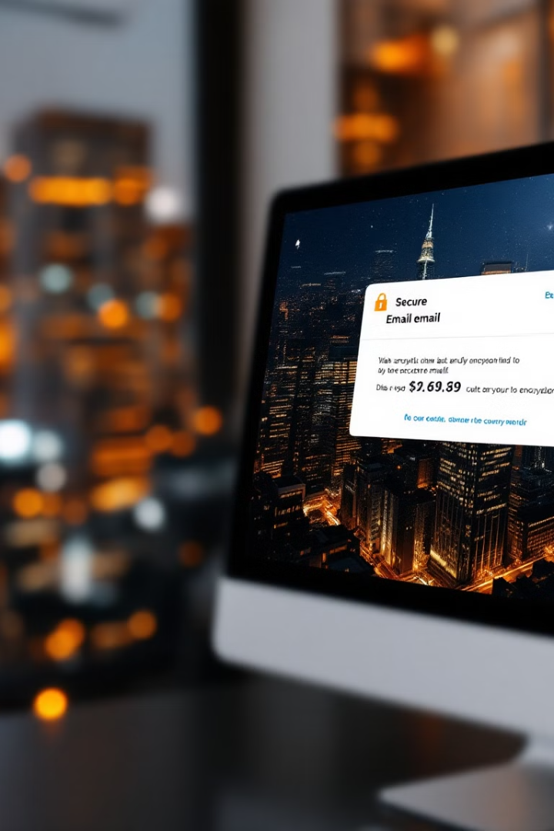
Secure Data Encryption and Privacy Protection
Data Encryption
Ensures your emails are protected from unauthorized access.
Privacy Protection
Safeguards your personal information and prevents unauthorized disclosure.
Two-Factor Authentication
Adds an extra layer of security to your account, protecting against unauthorized access.

Slide 8
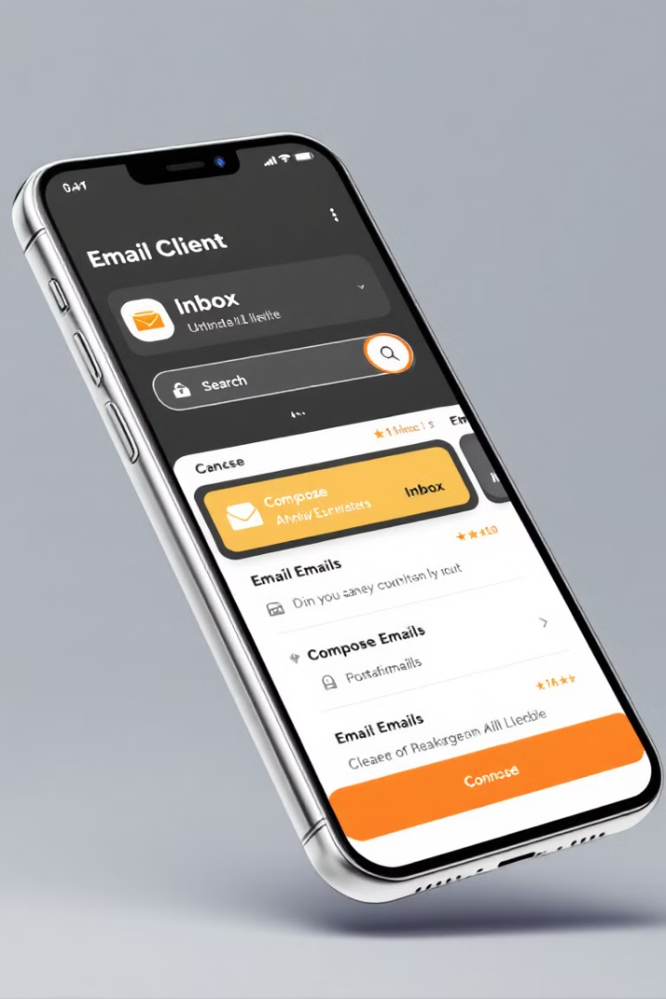



Intuitive Mobile Experience for On-the-Go Accessibility
Mobile Optimization
The app is designed to be user-friendly and efficient on mobile devices.
Cloud Synchronization
Access your emails from any device, ensuring your data is always synchronized.
Real-Time Notifications
Receive instant notifications for new emails, ensuring you stay informed on the go.

Slide 9
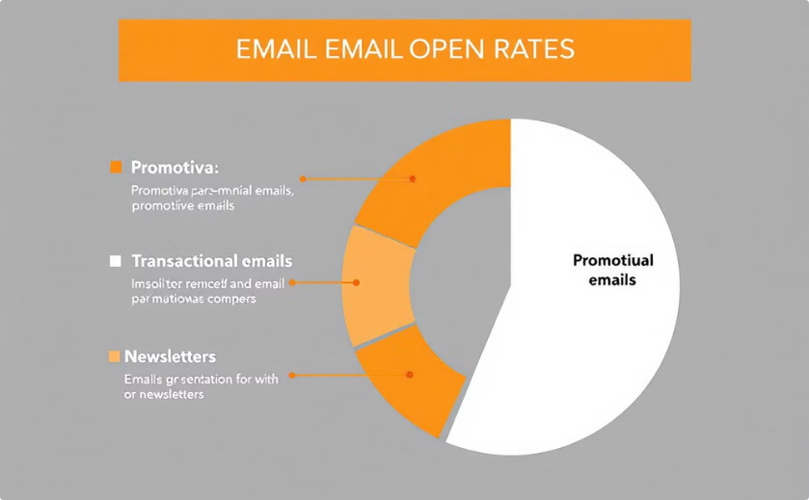
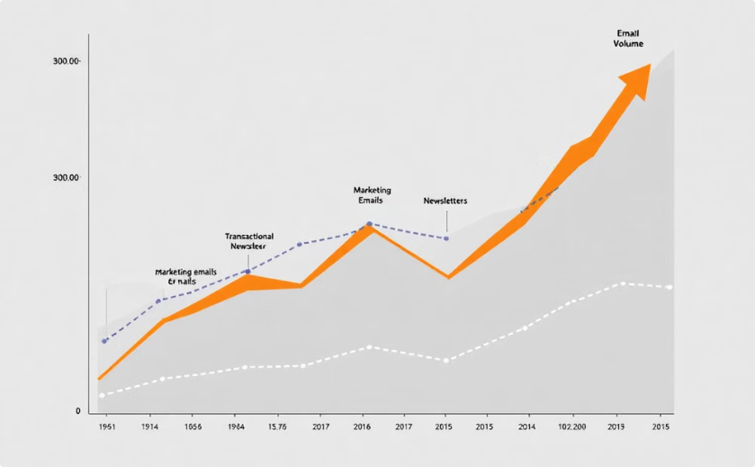
Advanced Analytics and Reporting for Improved Productivity
Email Engagement
Email Send Volume
Track email open rates, click-through rates, and response times to understand what's working and what's not.
Analyze email send volume over time to identify trends and optimize your email strategy.

Slide 10

The Future of Adaptive Email: Roadmap and Next Steps
1
AI-Powered Features
2
Integration with More Tools
We are exploring the use of artificial intelligence to enhance email automation and personalization.
We plan to expand our integrations with other productivity tools and platforms.
3
Enhanced Security Measures
We are constantly working to improve the security of our app and protect your data.

Slide 11
Standalone vs. Web-Based
Functionality Comparison
Security Considerations
Standalone email clients provide extensive features such as offline access and advanced organizational tools, making them ideal for users needing robust email management. In contrast, web-based clients excel in accessibility and automatic updates, catering to users who prioritize flexibility and ease of use across multiple devices.
Standalone clients often offer enhanced security through local data storage and encryption, appealing to users handling sensitive information. Conversely, web-based clients rely on cloud security measures, which may be suitable for users who value convenience but should be aware of potential privacy concerns associated with online data storage.

Slide 12
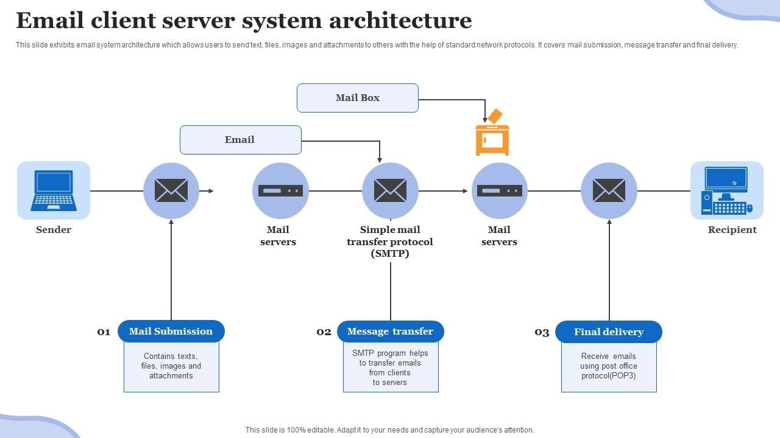

Slide 13
Comparing Popular Email Clients
Key Considerations for Selection
When comparing popular email clients, it is essential to evaluate factors such as user interface design, integration capabilities with other tools, security features, customization options, and overall user experience to determine which client best meets individual or organizational communication needs.

Slide 14
Key Features
Multi-Account Support
Integrate various email accounts (Gmail, Outlook, Yahoo, etc.) in one app.
2. Customizable Folders and Labels
Create custom folders, labels, and tags to categorize emails in your own way.
3. Unified Inbox
View all emails in a single inbox or filter by specific accounts.
4. Smart Filters & Prioritization
AI-powered filters to prioritize important emails, snooze less urgent ones, and sort newsletters.

Slide 15
Customization Options
1.Personalized Themes & Layouts
Dark mode, custom color schemes, font choices, and adjustable layouts.
2.Custom Email Signatures
Tailor your email signature for different accounts or purposes.
3.Swipe Gestures & Shortcuts
Set custom swipe actions (archive, delete, mark as read, etc.).
4.Notifications & Alerts
Set up notifications based on specific senders, subjects, or keywords.

Slide 16
Integration with Other Apps
1.Calendar Integration
Sync with your calendar to convert emails into events or reminders.
2.Task Management Tools
Convert emails into to-do items or sync with project management
tools like Trello, Asana, etc.
3.Cloud Storage Integration
Attach files from Google Drive, Dropbox, OneDrive, etc.,
directly into emails.

Slide 17
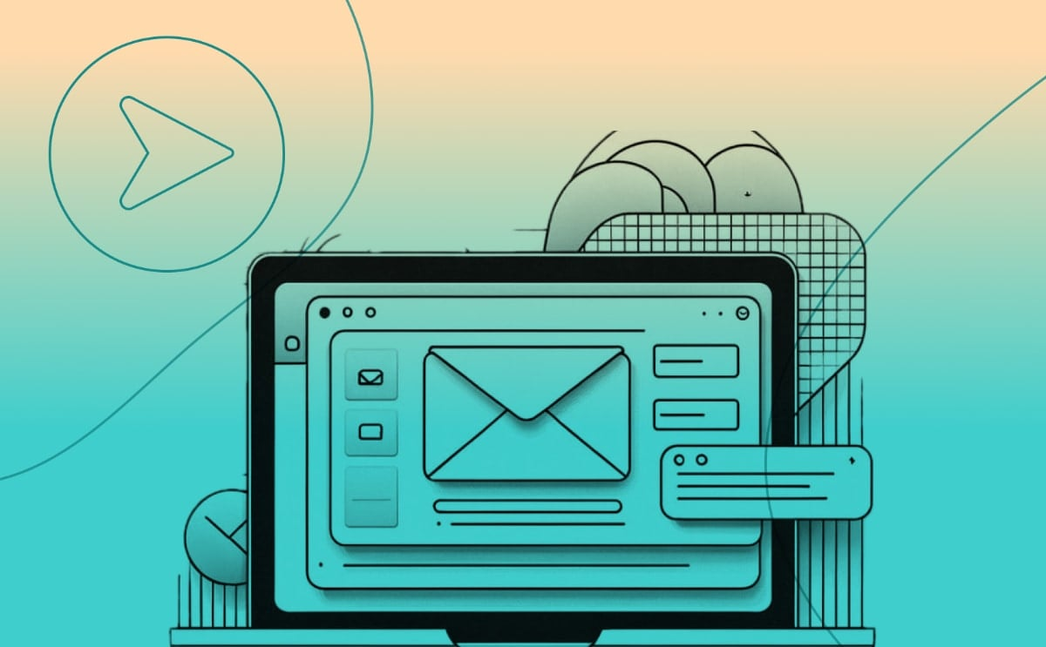
Benefits for Users
Time-Saving Features
Reduce the time spent managing and organizing emails.
Enhanced Productivity
AI-driven prioritization and automatic email sorting boost productivity.
Better Focus
Less clutter and distractions with customizable inbox management.

Slide 18
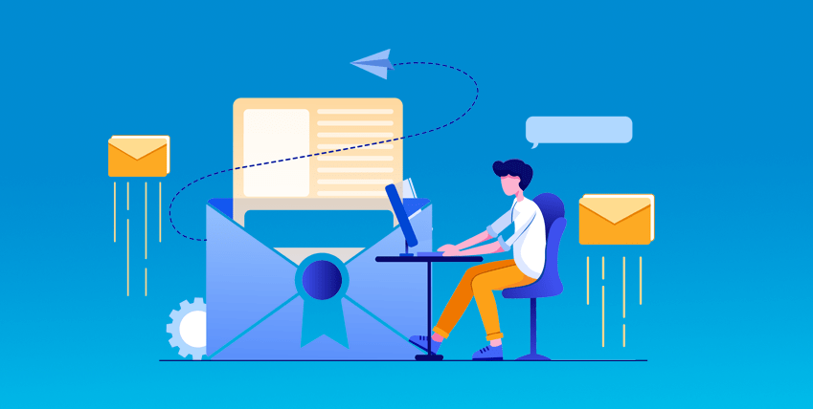
Target Audience
1.Business Professionals
Manage work and personal emails more efficiently.
2.Frequent Travelers
Stay organized across devices and time zones.
3.Small Business Owners
Simplify email communication with clients, suppliers, and teams.
4.Students & Academics
Organize study materials, projects, and research efficiently.

Slide 19
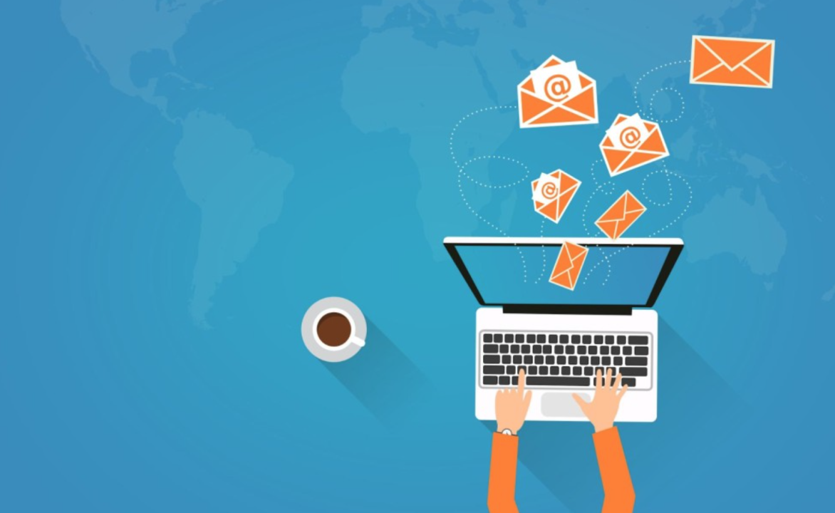
Roadmap and Future Updates
1.Version 1.0
Initial launch with multi-account support, smart filters, and customization options.
2.Version 2.0
Enhanced AI capabilities, better search filters, and collaboration features.
3.Version 3.0
Integration with additional tools, like Slack, and advanced analytics.

Slide 20
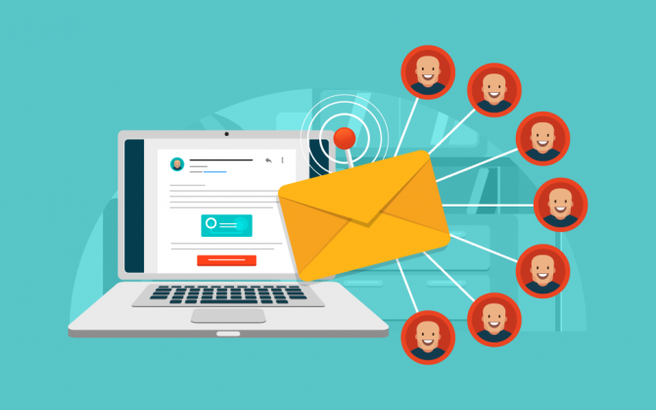
THANK YOU

